Slide 1



trade-offs in fair redistricting
zachary schutzman
@zschutzy
ianzach@seas.upenn.edu
https://zachschutzman.com

Slide 2
what is redistricting?
periodically, we need to redraw

Slide 3
what is redistricting?
congressional districts
periodically, we need to redraw

Slide 4
what is redistricting?
congressional districts
state legislative districts
periodically, we need to redraw

Slide 5
what is redistricting?
congressional districts
state legislative districts
county districts
judicial districts
municipal districts
periodically, we need to redraw

Slide 6
what is redistricting?
congressional districts
state legislative districts
county districts
judicial districts
municipal districts
school board districts
school attendance zones
periodically, we need to redraw

Slide 7
what is redistricting?
congressional districts
state legislative districts
county districts
judicial districts
municipal districts
school board districts
school attendance zones
library districts
voting precincts
emergency services districts
...
periodically, we need to redraw

Slide 8
what is redistricting?
congressional districts
state legislative districts
county districts
judicial districts
municipal districts
school board districts
school attendance zones
library districts
voting precincts
emergency services districts
...
periodically, we need to redraw
districts are often drawn by people with a personal interest in the outcome

Slide 9
what is redistricting?
congressional districts
state legislative districts
county districts
judicial districts
municipal districts
school board districts
school attendance zones
library districts
voting precincts
emergency services districts
...
periodically, we need to redraw
districts are often drawn by people with a personal interest in the outcome
state legislators draw their own districts

Slide 10
what is redistricting?
congressional districts
state legislative districts
county districts
judicial districts
municipal districts
school board districts
school attendance zones
library districts
voting precincts
emergency services districts
...
periodically, we need to redraw
districts are often drawn by people with a personal interest in the outcome
state legislators draw their own districts
draw a school zone so my kid and their friends go to the same school

Slide 11
history of abuse, but unfairness is judged ad hoc and is often hard to articulate

Slide 12
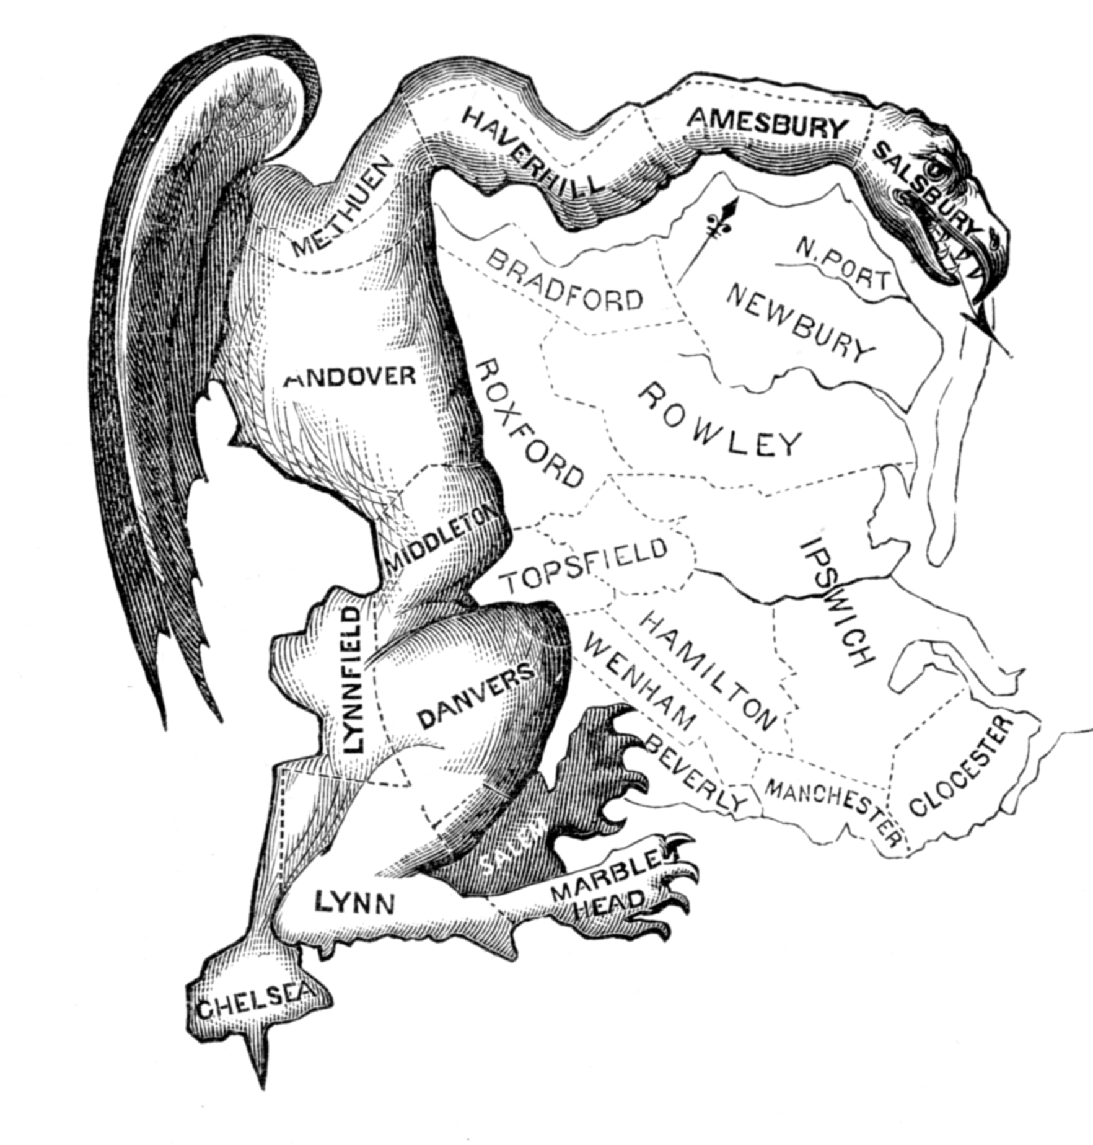
essex county, ma: 1812 state senate districting plan designed to help elbridge gerry’s political party

Slide 13
essex county, ma: 1812 state senate districting plan designed to help elbridge gerry’s political party
this district is oddly-shaped, advantages one party in particular

Slide 14
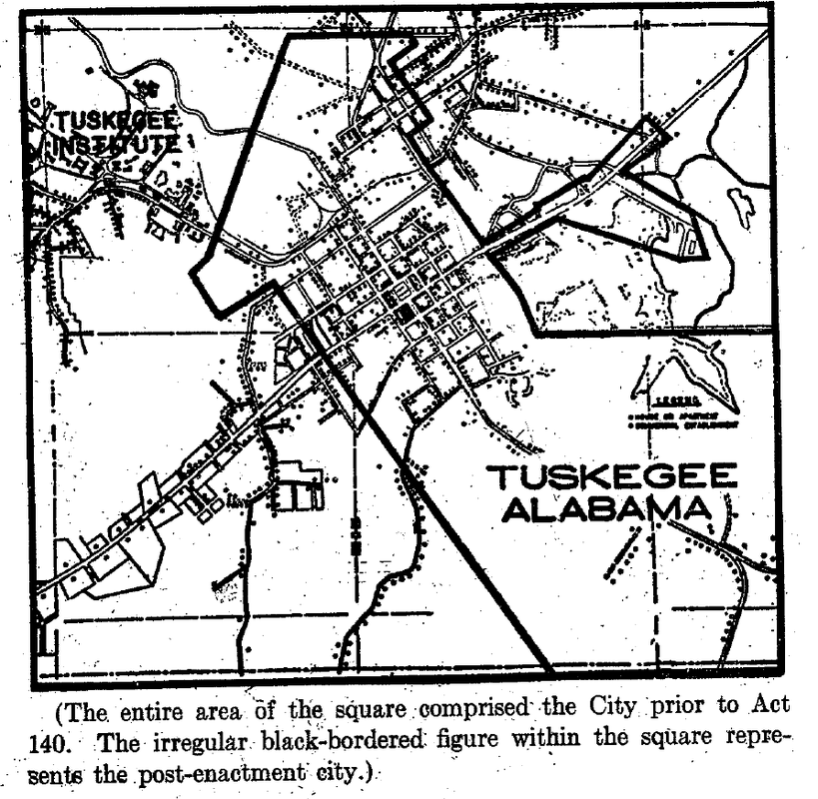


Slide 15
tuskegee, al, 1957: state disincorporated black areas of the city

Slide 16
tuskegee, al, 1957: state disincorporated black areas of the city (~80% of the population!)

Slide 17
tuskegee, al, 1957: state disincorporated black areas of the city (~80% of the population!) to prevent participation in municipal government

Slide 18
tuskegee, al, 1957: state disincorporated black areas of the city (~80% of the population!) to prevent participation in municipal government
scotus: redrawing city boundaries serves “no countervailing municipal function”

Slide 19
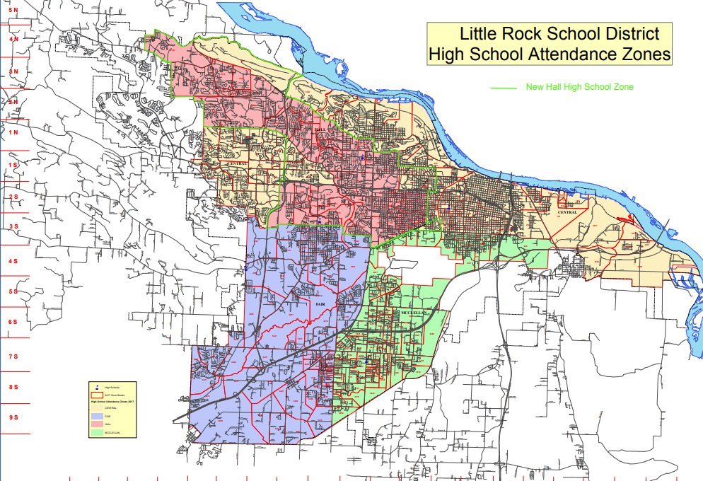
little rock, arkansas: 2011-2019 school attendance zone lines

Slide 20
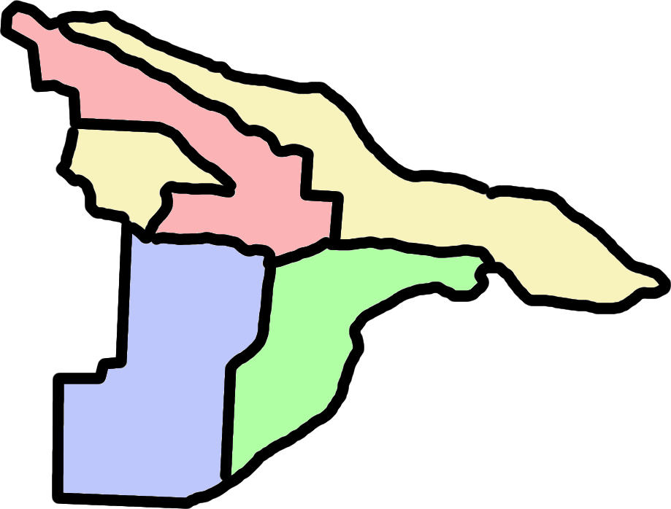
central
little rock, arkansas: 2011-2019 school attendance zone lines
hall
fair
mcclellan

Slide 21
little rock, arkansas: 2011-2019 school attendance zone lines
this plan treats black students systematically worse than white students

Slide 22
“This means, in view of the subtle possibilities for favoritism, that the human element must be removed as completely as possible from the redistricting process. In part, this means that the process should be completely mechanical, so that once set up, there is no room at all for human choice. More than this, [...] it should not be possible to predict in any detail the outcome of the process.”
On the Prevention of Gerrymandering, William Vickrey, 1961

Slide 23
if you can quantify it, you can optimize for it

Slide 24
if you can quantify it, you can optimize for it
proposed algorithms since the ‘60s

Slide 25
if you can quantify it, you can optimize for it
proposed algorithms since the ‘60s
most minimizing some geometric energy

Slide 26
if you can quantify it, you can optimize for it
proposed algorithms since the ‘60s
most minimizing some geometric energy
since vieth (2004), a search for a way to quantify partisan unfairness

Slide 27
if you can quantify it, you can optimize for it
proposed algorithms since the ‘60s
most minimizing some geometric energy
since vieth (2004), a search for a way to quantify partisan unfairness
computers caught up in ~2010

Slide 28
neutral process:
draw districts in a way that’s orthogonal to “human interests”
no (dis)favoritism to parties, groups, communities, or individuals
almost always formalized as “draw pretty shapes”

Slide 29
neutral process:
draw districts in a way that’s orthogonal to “human interests”
no (dis)favoritism to parties, groups, communities, or individuals
almost always formalized as “draw pretty shapes”
equitable outcome:
draw districts which give us a “fair” outcome
districts shouldn’t systematically (dis)advantage any group, community, or individual
very hard to formalize and even harder to remedy, lots of attention currently to partisan (un)fairness

Slide 30
what are the trade-offs between these two frameworks?

Slide 31
neutrality: compactness
draw districts to be as nicely-shaped as possible
equitable outcome: partisan symmetry
answer questions like “how different is the seats outcome when republicans get 55% of the vote from when democrats do?”

Slide 32
data: pennsylvania and north carolina
drawing districts at the precinct level
use an mcmc package to draw hundreds of thousands of plans
evaluate compactness and partisan symmetry

Slide 33
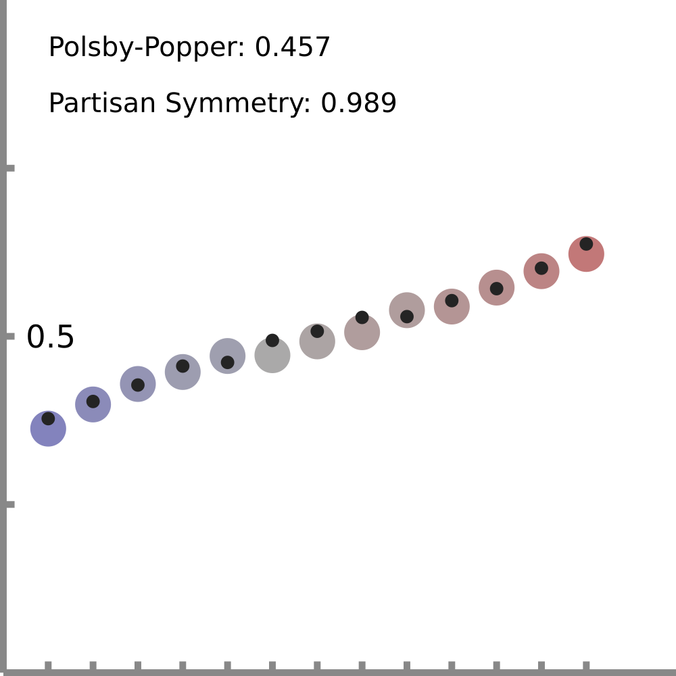
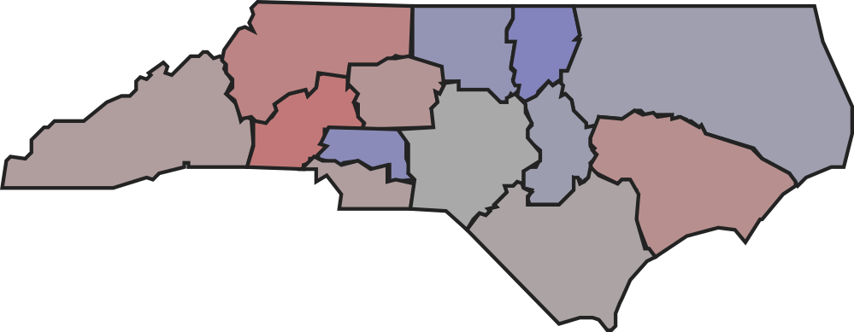
Compactness

Slide 34
Compactness

Slide 35
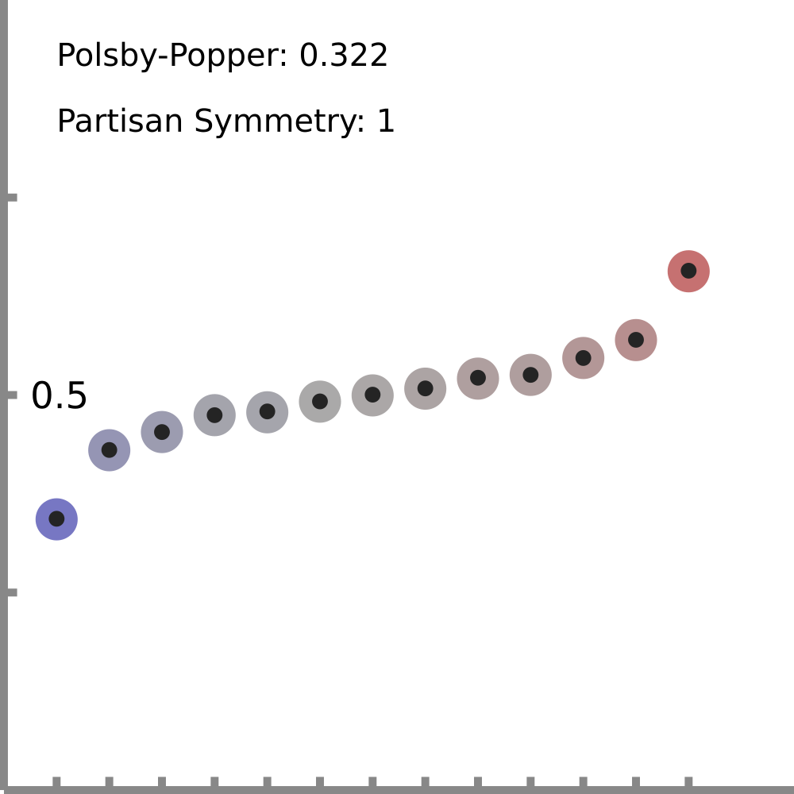

Slide 36
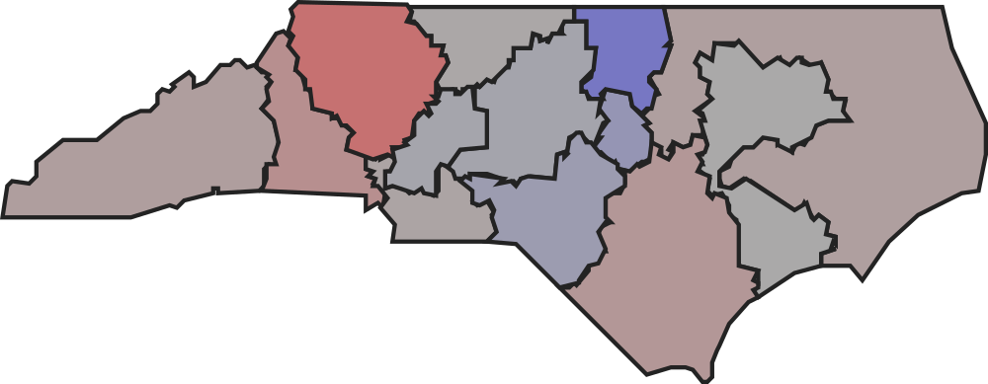
Compactness:

Slide 37
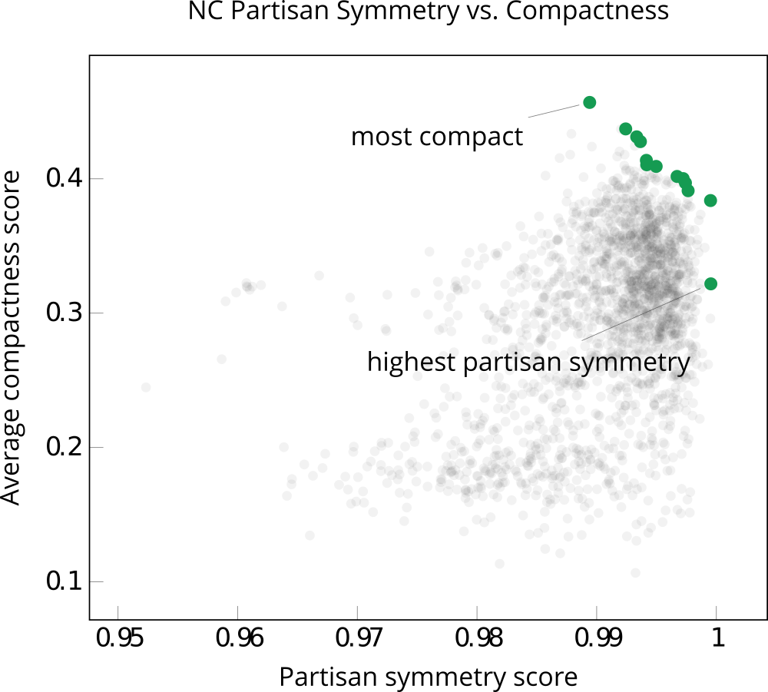

Slide 38
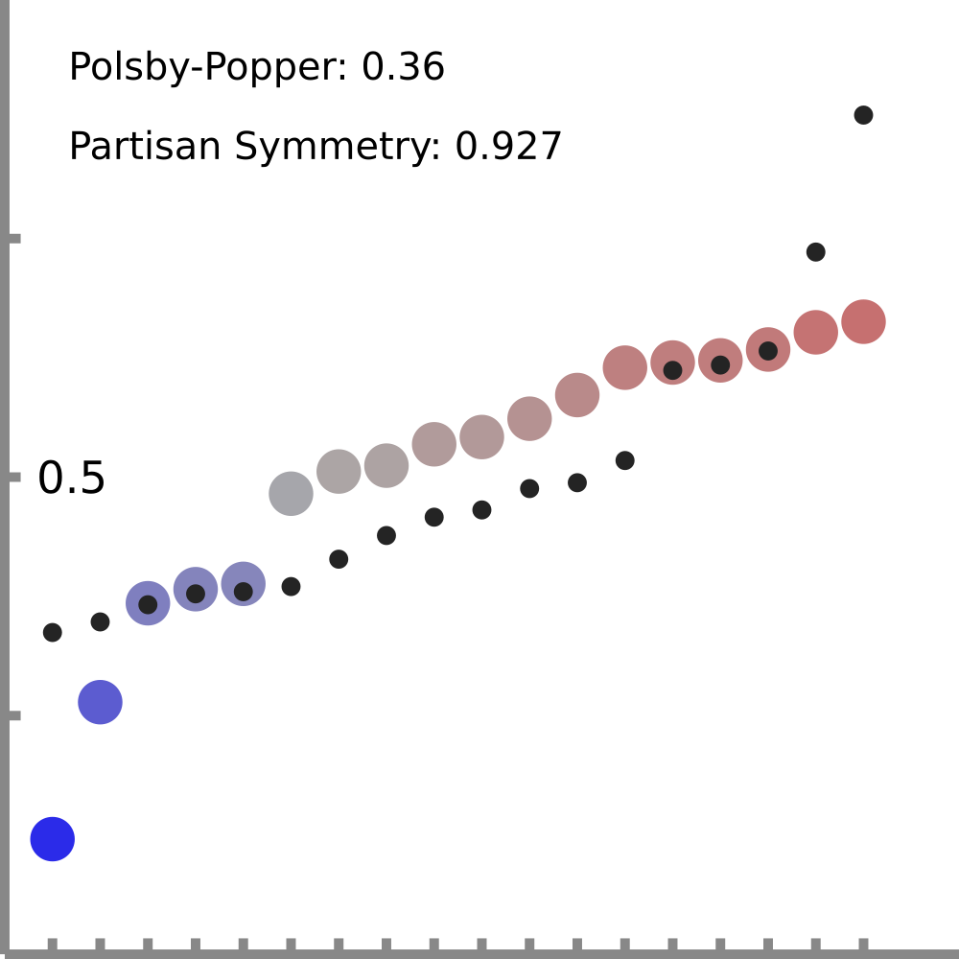
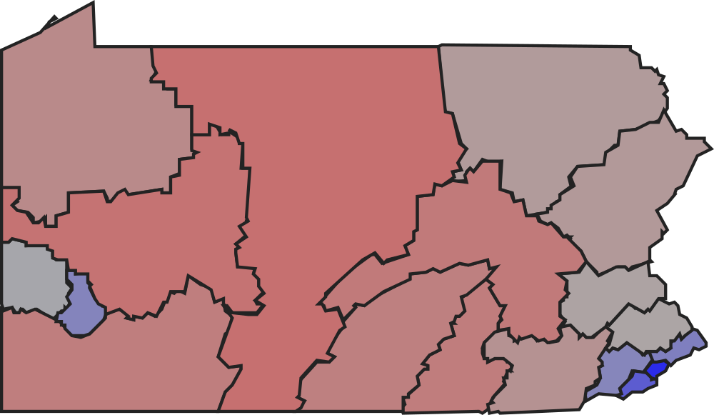
Compactness:

Slide 39
Compactness:

Slide 40
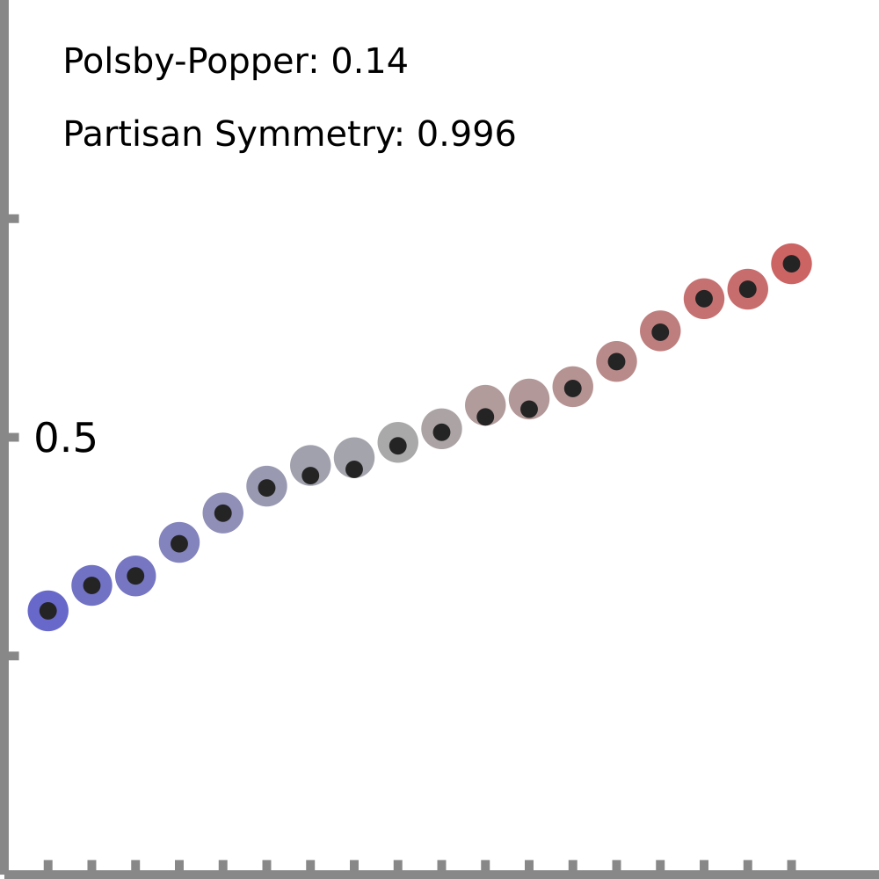

Slide 41
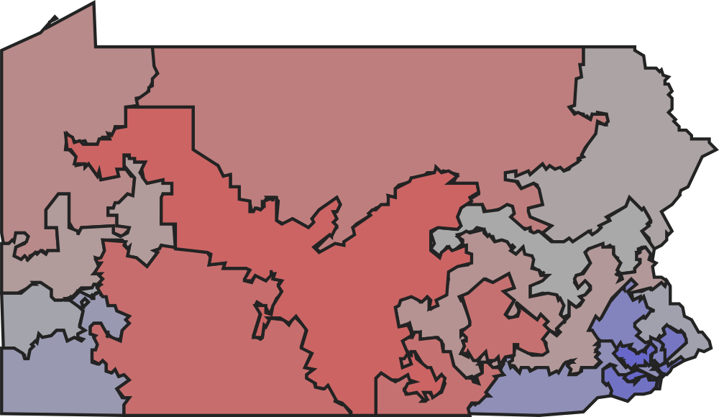
Compactness:

Slide 42
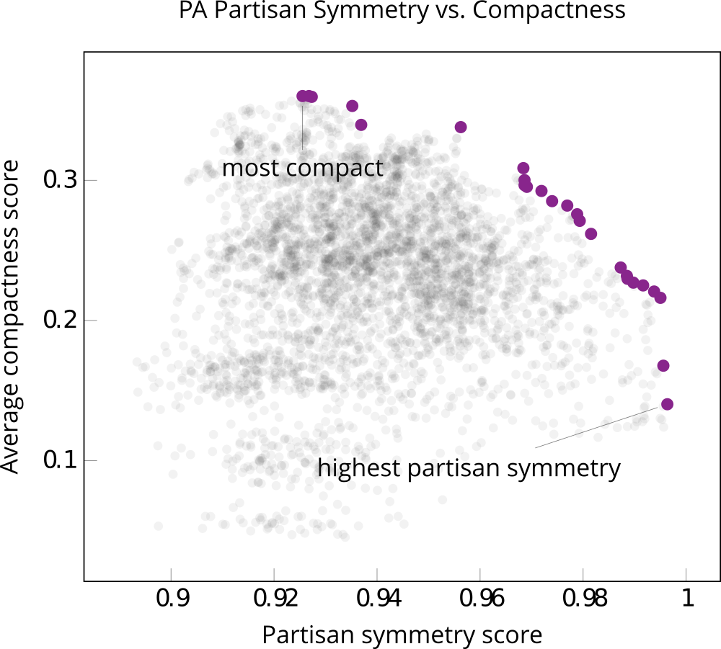

Slide 43
algorithmic redistricting is possible

Slide 44
algorithmic redistricting is possible … but its value and impacts are not clear

Slide 45
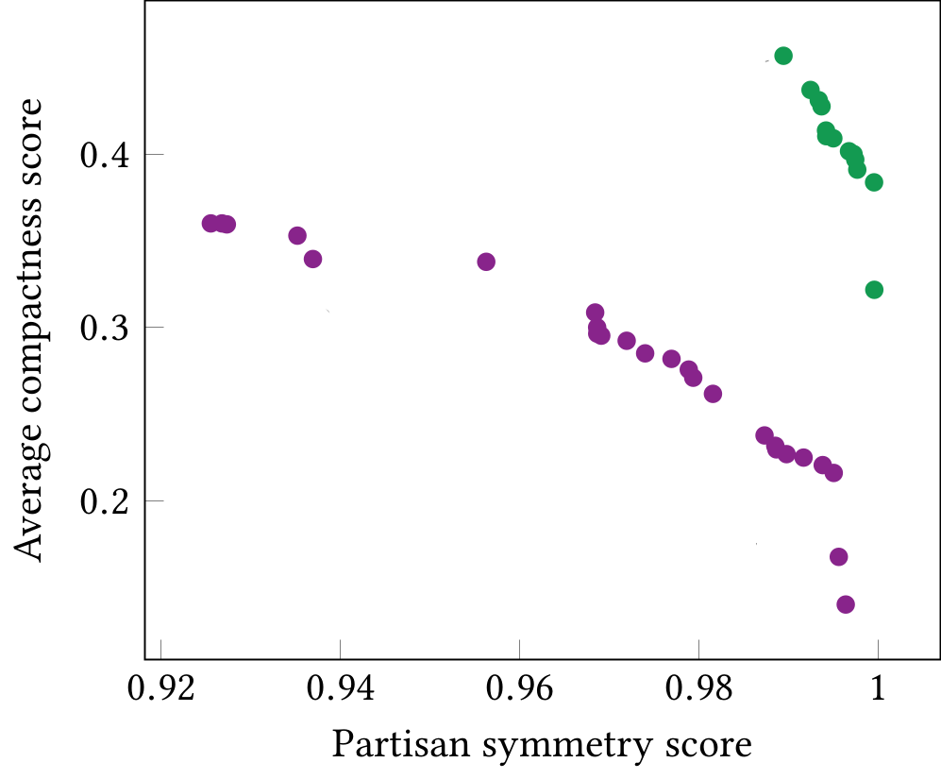
one-size-does-not-fit-all

Slide 46
other factors are important but hard to operationalize
vra compliance
defining and preserving communities-of-interest
concordance with other legal constraints

Slide 47
thank you!
@zschutzy
ianzach@seas.upenn.edu
https://zachschutzman.com

